Slide 1
Pandora
A Subscription-Based Music Streaming Platform
By Jacob Gleco

Slide 2
Describing Pandora
What is a music streaming platform?
It is a service that allows users to listen to...
  Music
  Podcasts
  Audiobooks
all available on mobile and computer devices
Pandora is ranked the #1 grossing for music and audio

Slide 3
Key Features of Pandora
Pandora allows you to...
  Browse stations of bands you like
  Find songs for your personal playlist(s)
  Listen to your favorite podcasts
  Skip songs you do not like or are not in the mood for
  Play your choices offline
  Leave a like or dislike on a song to personalize your preferences

Slide 4
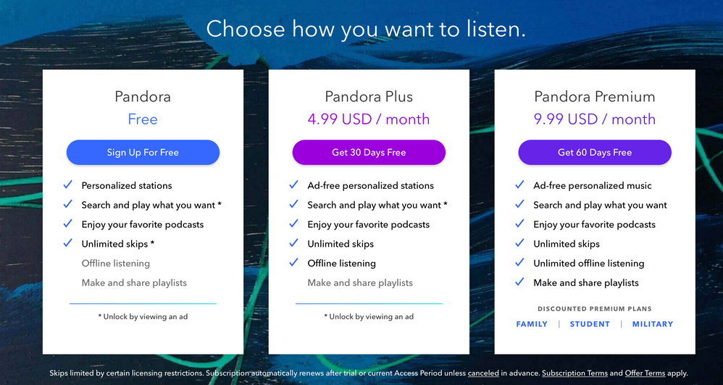
Subscription Plans

Slide 5
Getting Started with Pandora
Here is how to get started
Sign up for free or buy a subscription
Find your favorite artists
Enjoy listening to your music

Slide 6
Pandora Community
You can also visit Pandora Community
It is a place to connect with creators and fans to discuss music
Visitors are available to...
  Ask questions
  Find solutions
  Share ideas

